Slide 1
Paper Sharing
夏润泽 2023-10-18

Slide 2
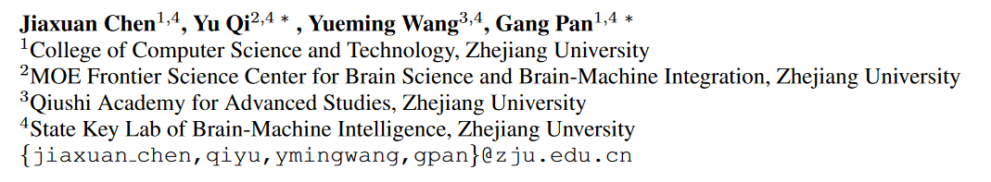
MINDGPT: Interpreting What You See With Non-invasive Brain Recordings
arXiv:2309.15729v1 [cs.CV] 27 Sep 2023

Slide 3
Motivation
1. Decoding of seen visual contents has important scientific and practical values. 2. Semantic information conveyed in language, is deeply intertwined and entangled with various types of sensory input, especially for vision.
We introduce a new “mind reading” technology, aiming to verbally interpret what you see. This study focuses on whether and to what extent the static visual sensory experiences such as a single image provide semantic labels for our amodal language maps.
(单个图片的视觉经验能提供多少语义信息？)

Slide 4
MindGPT
We introduce a non-invasive neural language decoder, termed as MindGPT, which translates the blood-oxygen-level-dependent (BOLD) patterns elicited by static visual stimuli into well-formed word sequence
two key criteria 1. it must be capable of capturing visual semantic representations (VSRs) from brain activities
2. should incorporate a mechanism to transition from acquired VSRs into well-formed word sequences.

Slide 5
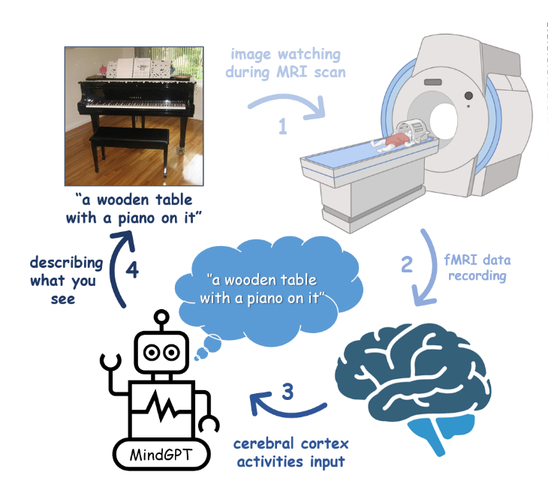
MindGPT
The overall pipeline of non-invasive language decoder MindGPT

Slide 6
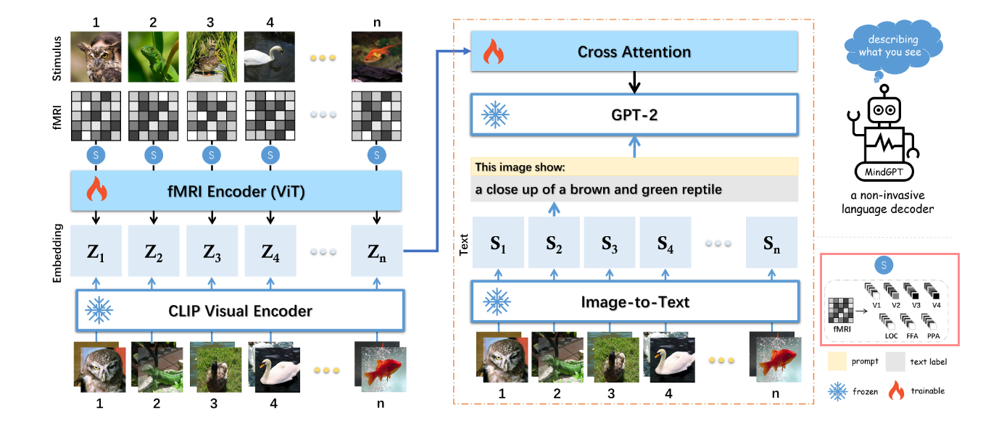
APPROACH
Schematic diagram of MindGPT framework

Slide 7
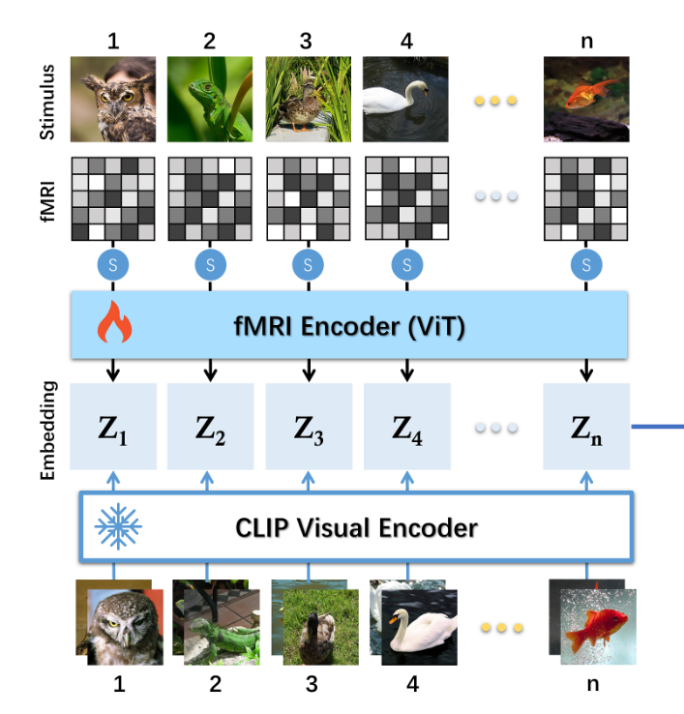

CLIP-GUIDED NEURAL EMBEDDING
1. Split the fMRI into a sequence of voxel vectors z ∈ R^{7×H} ，including V1-V4, LOC, FFA, and PPA, where H denotes the number of voxels 2. Next, voxel vectors z ∈ R^{7×H} are fed into a trainable linear projection, followed by a Transformer encoder, to predict latent fMRI representations Z. Training phase: we leverage the hidden class embedding Kclip ∈ R⁷⁶⁸ of CLIP visual encoder as neural proxy, and then seeking a joint semantic space across images and fMRI signals via fMRI-image representation alignment. (MSE LOSS)

Slide 8
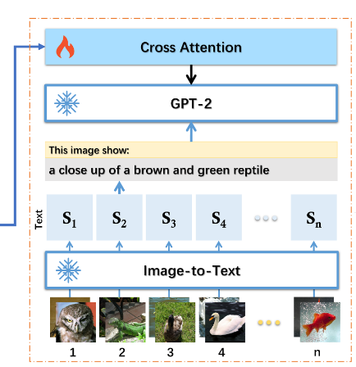
VISION-LANGUAGE JOINT MODELLING
we use multi-head cross-attention layers to bridge the fMRI encoder and GPT decoder, thus leaving each layer of the GPT decoder attends to the fMRI encoder outputs.

Slide 9
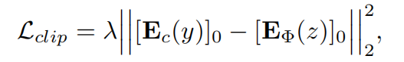
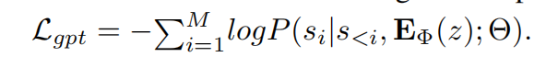
LOSS
where Ft(y) = [si ]1:M is a visual captioning of image y generated from SMALLCAP, Ec(·) denotes frozen CLIP encoder, which returns the hidden visual embedding Kclip ∈ R ⁷⁶⁸ , EΦ(·) indicates fMRI encoder with trainable parameters Φ, and Θ is the weights in the cross attention modules. where [·]₀ returns the class embedding of Transformer encoder, and λ = 10 is a trade-off hyperparameter weighing Lgpt and Lclip.
Overall, our MindGPT provides a mechanism to learn a direct mapping between brain activity and text by preserving language attributes under the guidance of visual cues, which brings desirable expandability

Slide 10
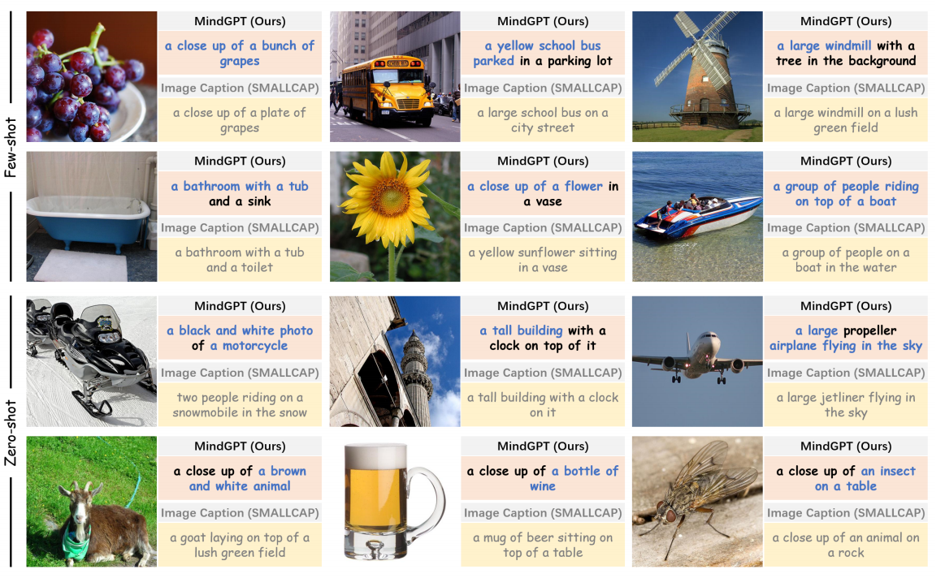

Qualitative Results
Note that the default training/test split of DIR has no overlapping image categories, we randomly sampled 50 fMRI-image training pairs, and added them to the test set for the few-shot evaluation.
MindGPT can produce semantically satisfying word sequences and even exact category names such as “airplane”, “windmill”, “grapes”, “school bus”, and “bathroom”. 可以看出有些地方是与图像不符 可能与训练策略有关，更注重泛化能力

Slide 11
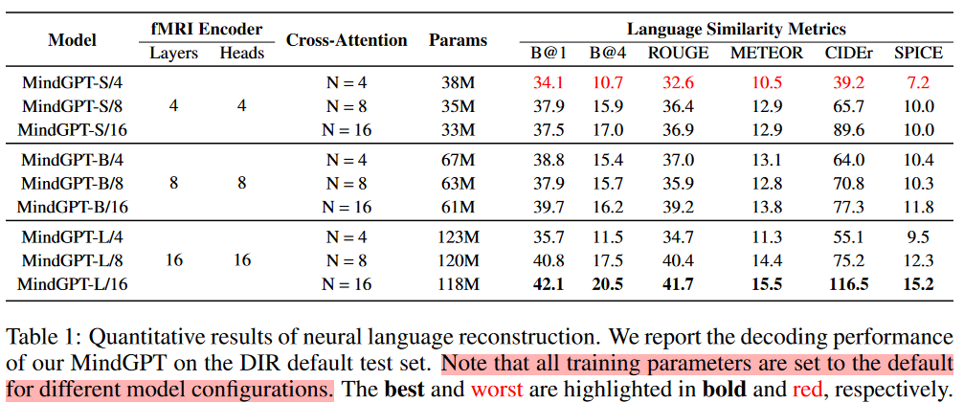
Quantitative Results
MindGPT-S/8 means the smaller variant, and the scaling factor N = 8 of cross-attention layers. Note that the number of parameters is inversely proportional to the scaling factor N .

Slide 12
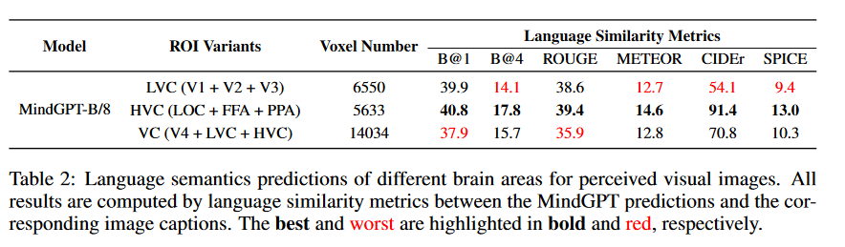
Performance of Different Brain Areas
Lower/Higher Visual cortex
Results: (1) Decoding from the HVC yielded the best performance on all language evaluation metrics; (2) the decoding performance of using complete VC is better than that of LVC (3) there is no complementary relationship between LVC and HVC.

Slide 13
Analysis of the Latent Neural Representations
Examining the representation distributions of different brain regions is beneficial to further explain the above phenomena. we leverage the t-SNE technique to visualize the distributions of fMRI representations.

Slide 14
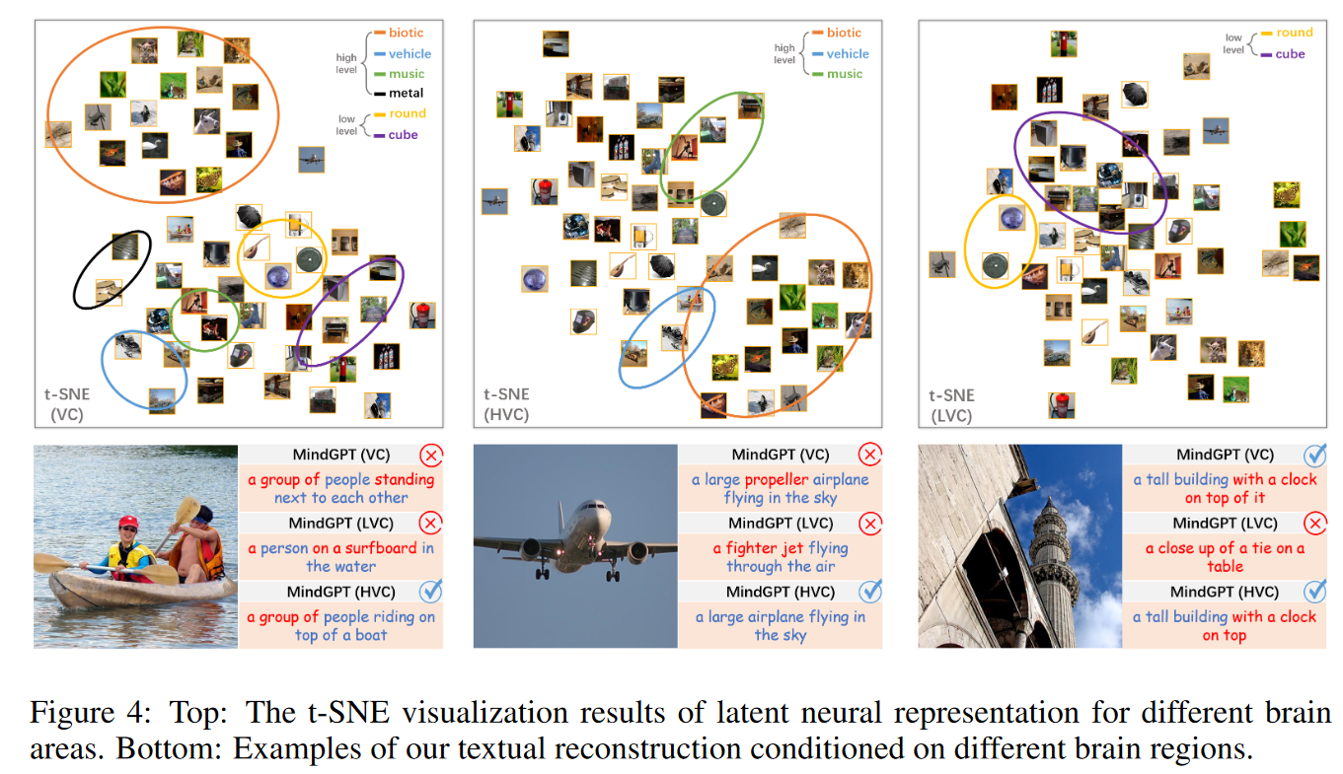
Analysis of the Latent Neural Representations We separately map VC, LVC, and HVC neural representations to 2-dimensional t-SNE embedding spaces, and put the corresponding visual stimulus at the position
From the visualization results of VC and HVC, we can observe that our MindGPT learned a locality-sensitive embedding structure, which contains several clusters representing different high-level semantic properties or concepts, e.g., biotic, vehicle, and music. The embedding structure of LVC, by contrast, has no obvious clustering rule.

Slide 15
why is there a performance degradation when using the entire VC?
The reason for the performance decline with VC may be that each brain region has a non-trivial probability of decoding failure, which means that the more brain areas we use, the harder it is to guarantee that all of the brain areas are always functional within the existing learning paradigm.

Slide 16
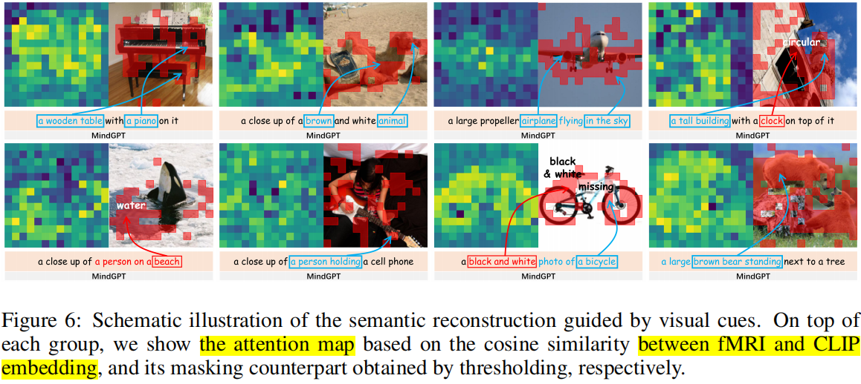
DISCOVERING THE VISUAL CUES THAT GUIDE SEMANTIC RECONSTRUCTION
Since humans often pay attention to task-related objects based on the high-level task at hand, it is not yet clear whether such visual attention information is present in neural signals, which motivates future decoding efforts.
In order to discover the visual cues that guide semantic reconstruction, our practice is using a CLIP visual encoder with 16 × 16 input patch size (i.e., CLIP-ViT-B/16) to produce a sequence of image patch embeddings, and then calculating the cosine similarity matrix between each image patch embedding and the class embedding of fMRI.

Slide 17
DISCUSSION
Conclusion: there might be a rich connection between the amodal semantic concept and visual objects of the physical world.
Questions: whether the amount of semantic information provided to the VC can be quantified by the selective visual attention of humans.

Slide 18
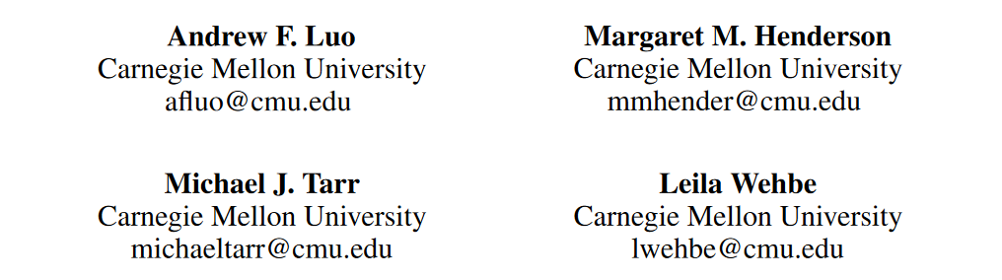
BRAINSCUBA: fine-grained natural language captions of visual cortex selectivity
arXiv:2310.04420v1 [cs.LG] 6 Oct 2023

Slide 19
Motivation
高级视觉皮层中存在对特定视觉类别（如Face、Food…）响应的区域，传统验证方法使用手工设计的刺激对某一区域进行验证。这样的方法无法反映复杂的自然视觉环境，限制了对脑区的理解。
本文提出一种数据驱动的框架BrainSCUBA(Semantic Captioning Using Brain Alignments)，生成在视觉刺激下每个体素(voxel)的Language Caption，并从Caption分析脑区对特定视觉刺激的响应。
简言之，就是探究不同脑区对哪种视觉刺激更活跃

Slide 20
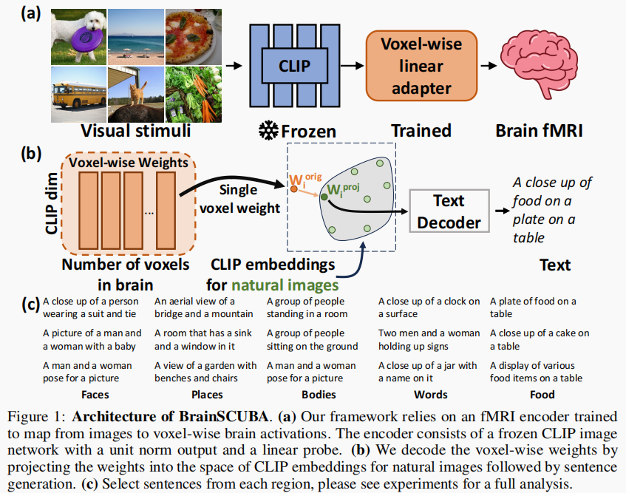
BrainSCUBA framework
构建编码器将CLIP特征映射到体素级别(voxel level)的大脑激活。
为每个体素提取最优嵌入，使用免训练方式缩小Encoder Weight Space 和image 模态之间的gap.
每个voxel都能够生成对应的Caption

Slide 21
Next
we show that our method captures the categorical selectivity of multiple regions in visual cortex. 捕获区域的类别选择（对应的刺激类别）。
We further show that BrainSCUBA combined with a text-to-image model can generate images semantically aligned with targeted brain regions and yield high predicted activations when evaluated with a different encoder backbone. 进一步生成与该区域对齐的图像。
Finally, we use BrainSCUBA to perform data-driven exploration for the coding of the category “person” 对“人”这一类别进一步探索。

Slide 22
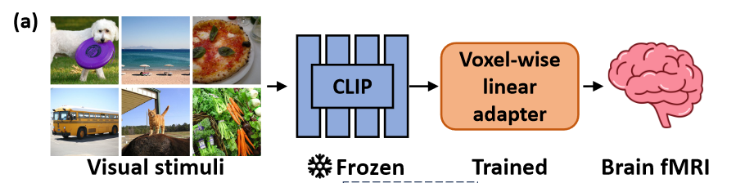
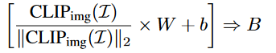
IMAGE-TO-BRAIN ENCODER CONSTRUCTION
W*H*3 1*M M*N 1*N
LOSS:MSE

Slide 23
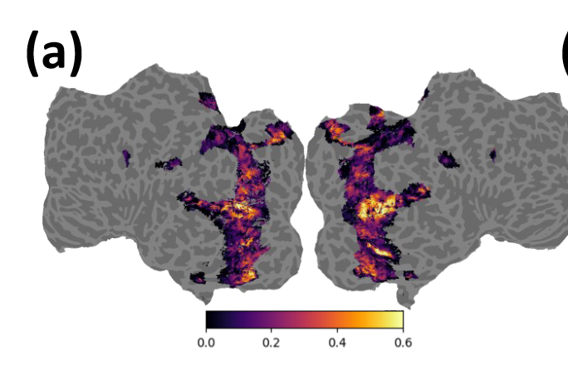
achieve high accuracy(R2) in the higher visual cortex

Slide 24
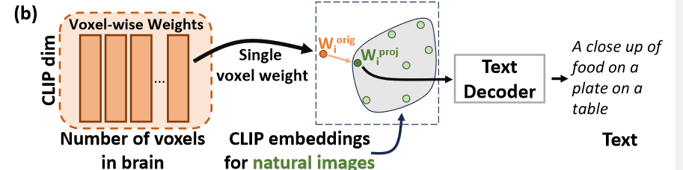
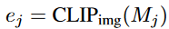
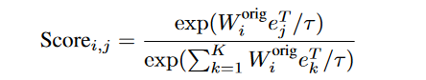
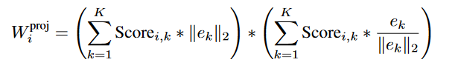
DERIVING THE OPTIMAL EMBEDDING AND CLOSING THE GAP
a set with K natural images M = {M1, M2, M3, · · · , MK }.

Slide 25
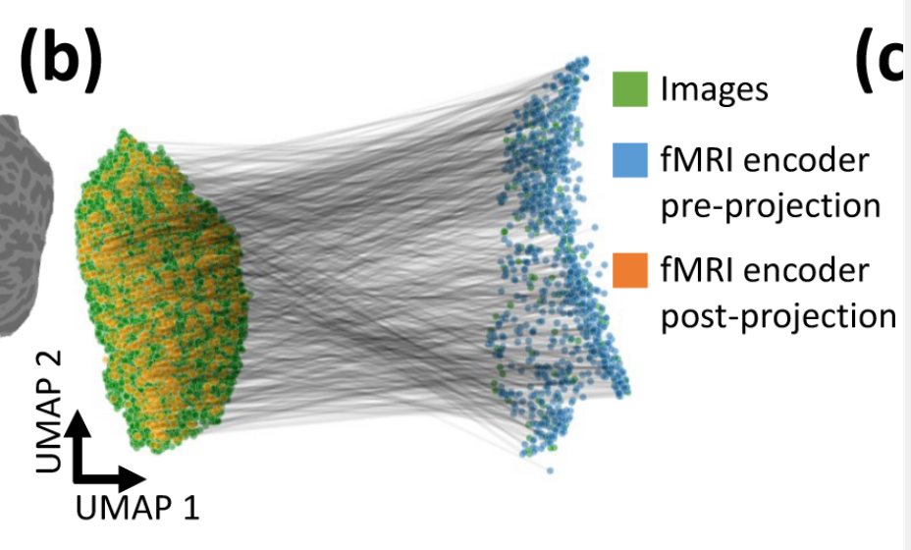
UMAP可视化project前后与image之间的gap
经过前页projection后，Wproj就到了CLIP embedding space 。。。。 再利用CLIPCap和GPT-2生成每个voxel的caption。

Slide 26
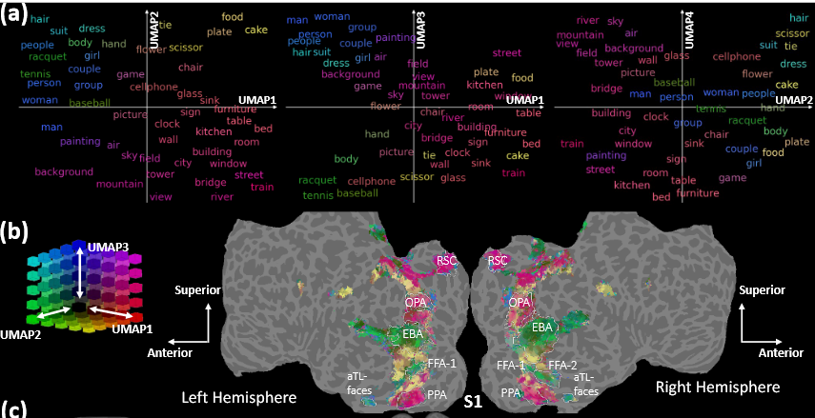
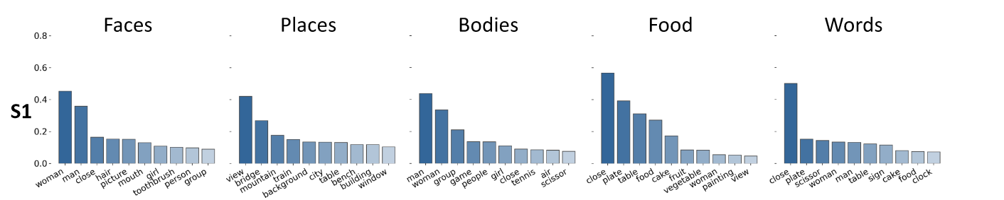
RESULTS：VOXEL-WISE TEXT GENERATIONS
从Caption中提取名词 ”A photo of a/an [NOUN]”提取名词的CLIP Embedding
将 noun embedding和voxel weight 映射到image embedding space UMAP可视化
We observe that the nouns generated by BrainSCUBA are conceptually aligned to pre-identified functional regions. Namely, voxels in extrastriate body area (EBA) are selective to nouns that indicate bodies and activities (green), fusiform face area (FFA-1/FFA-2) exhibits person/body noun selectivity (blue-green), place regions – retrosplenial cortex (RSC), occipital place area (OPA), and parahippocampal place area (PPA) – show selectivity for scene elements (magenta), and the food regions (yellow; Jain et al. (2023)) surrounding FFA exhibit selectivity for food-related nouns.
Top-10 BrainSCUBA nouns via voxel-wise captioning in broad category selective regions.

Slide 27
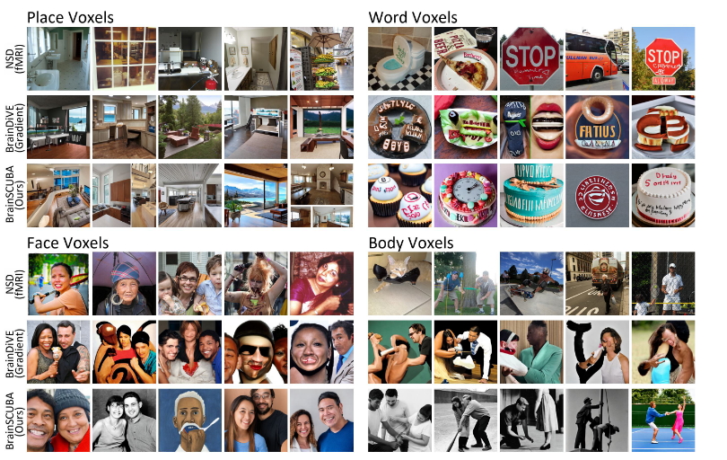
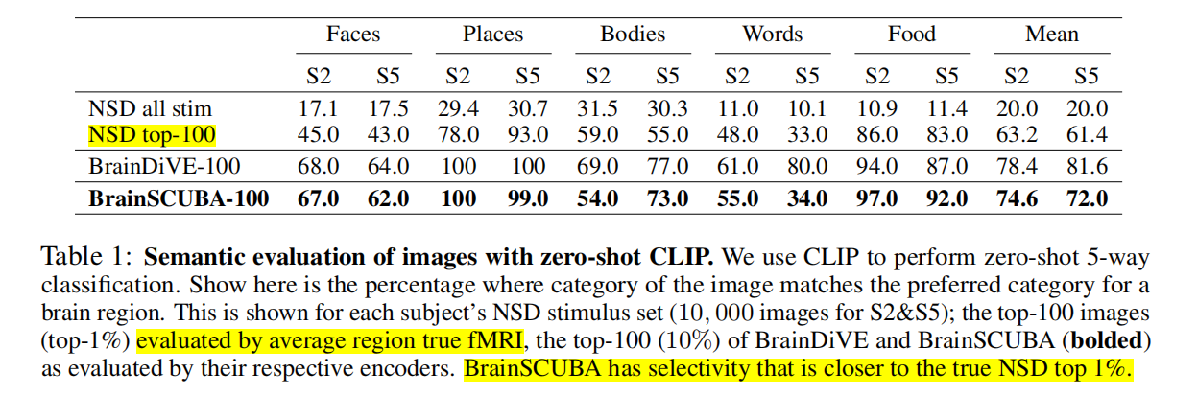
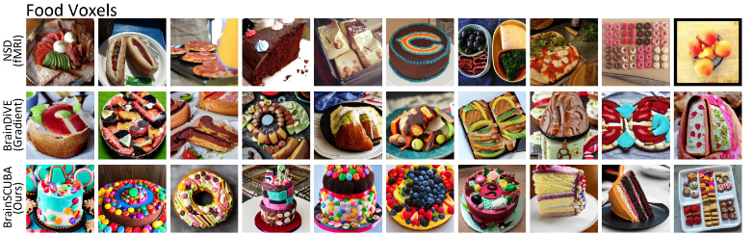
TEXT-GUIDED BRAIN IMAGE SYNTHESIS
Caption 可视化(text2image)
每个脑区中采样1000个image
取top5/10个image进行输出 排序按照预测的fmri脑区激活情况（第一步的模型image2brain） 每个区域的TOP100用来评测准确率
最能让这个区域激活的图片应该属于哪个类别？ （用CLIP分类器）

Slide 28
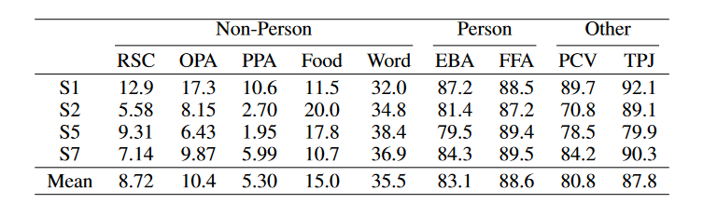
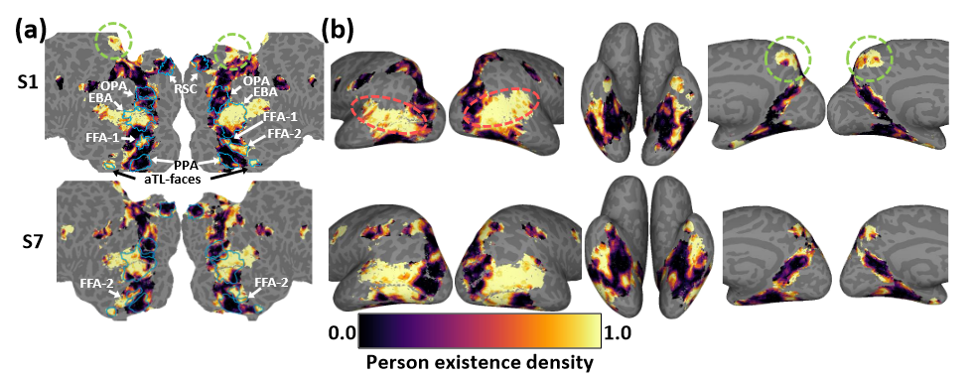
INVESTIGATING THE BRAIN’S SOCIAL NETWORK
“社会性”影响着视觉感知，故探究“人”在体素级编码的情况。 We use a rule based filter and count the number of captions that contain one of 140 nouns that describe people (person, man, woman, child, boy, girl, family, occupations, and plurals).
与预期相符：FFA和EBA包含“人”的密度大
另外的高密度区域 orange oval-----TPJ green circle-----PCV PCV — a region involved in thirdperson social interactions TPJ — a region involved in social self-other distinction.
Presence of people in captions

Slide 29
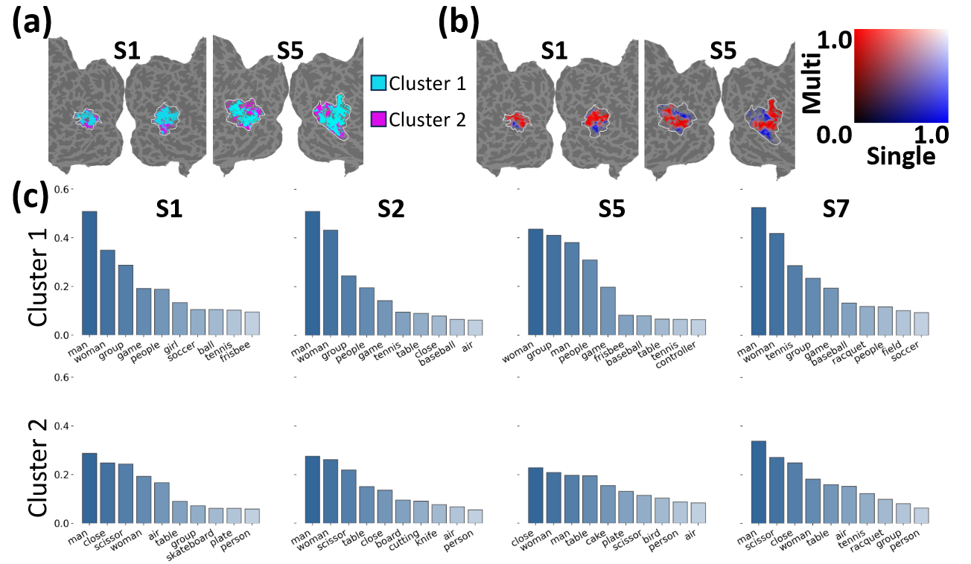
a divide within EBA
While both clusters include general person words like “man” and “woman”, cluster 1 has more nouns that suggest groups of people interacting together (group, game, people), and cluster 2 has words that suggest close-ups of individuals with objects that may be hand-held.

Slide 30
DISCUSSION
Limitations： our method reflects the biases of the captioning model. It is further not clear if the most selective object in each region can be perfectly captured by language. Conclusion： 1. generate voxel-wise captions to describe each voxel’s semantic selectivity. 2. explore how the output tiles the higher visual cortex 3. facilitate exploration of the visual cortex.

